Slide 1
Drawing the Blueprint for a Sustainable Natural Gas Future
Denver, Colorado
January 18, 2012
Mark K. Boling
Executive Vice President & General Counsel

Slide 2
The Promise of Natural Gas
The Environment
The Economy
Energy Security

Slide 3
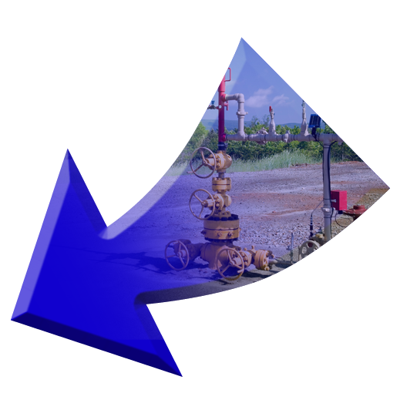
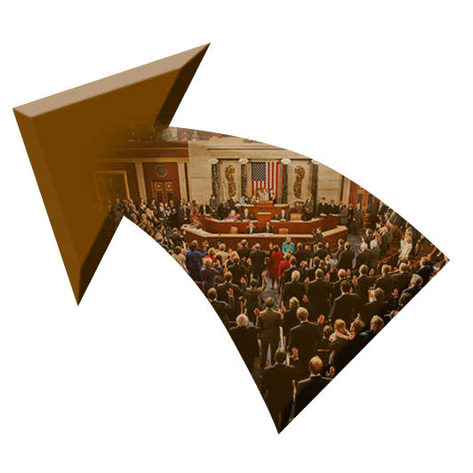
Current Regulatory Environment
Public Distrust and Fear
Natural Gas
Industry
The Environment
The Economy
THE
PERFECT
STORM
Energy Security
Certain
Environmental
Activists/Groups
Proposed
Federal
Legislation

Slide 4
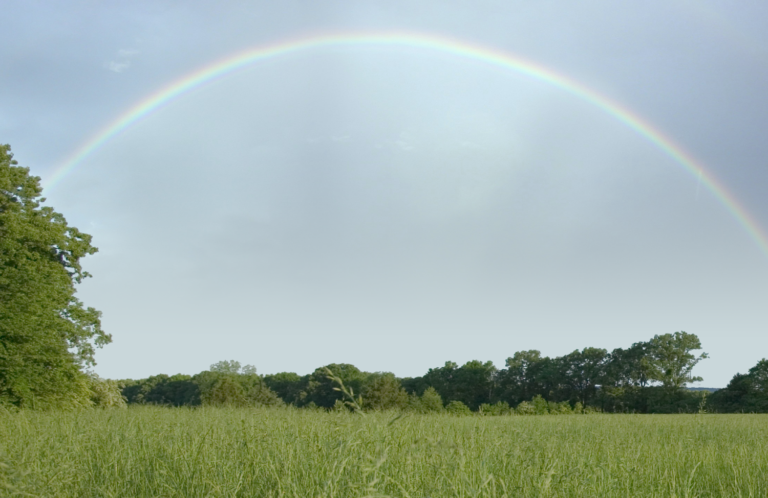
Refocusing the Debate
Dial Down the Rhetoric
Identify the Real Obstacles to Responsible Development of this Resource
Develop Workable Solutions to Overcome these Obstacles

Slide 5
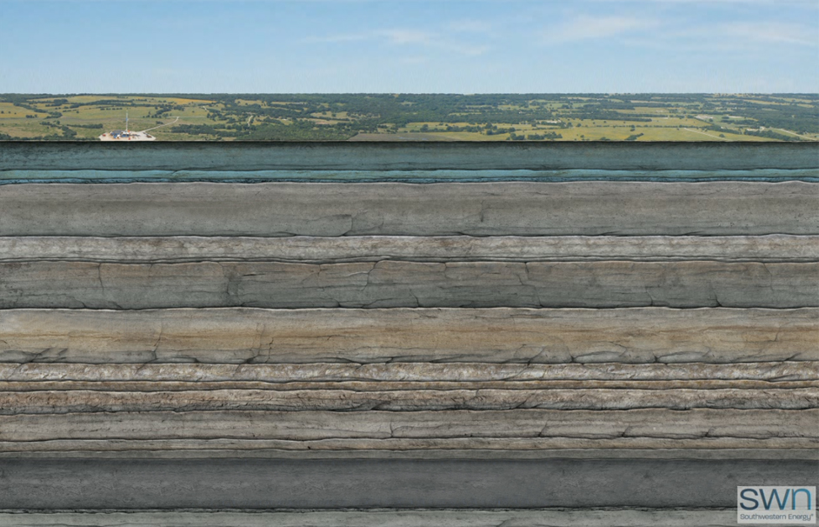
Regulatory Considerations
Surface Considerations
Subsurface Considerations

Slide 6
Regulatory Considerations
Subsurface Considerations
Protecting Underground Water Resources
Frac Fluid Disclosure

Slide 7
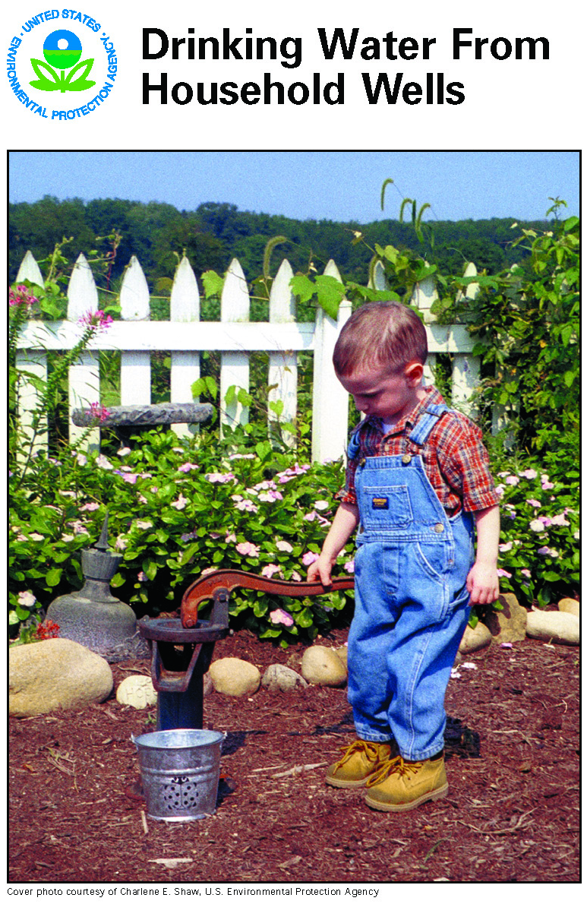
Protecting Underground Water Resources
Well Integrity
Is the Key!

Slide 8
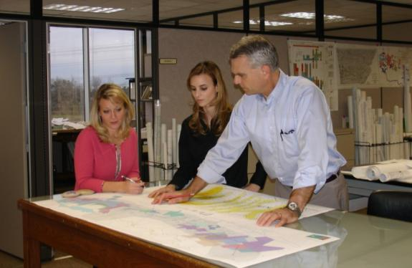
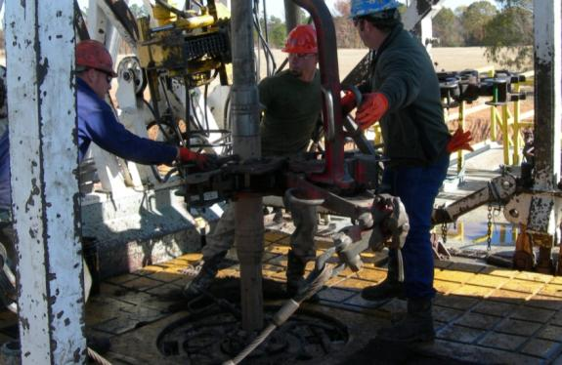
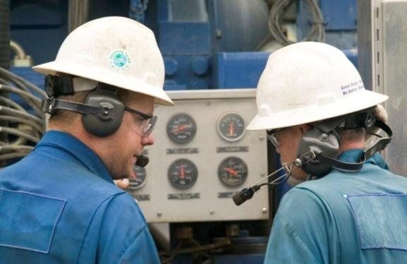
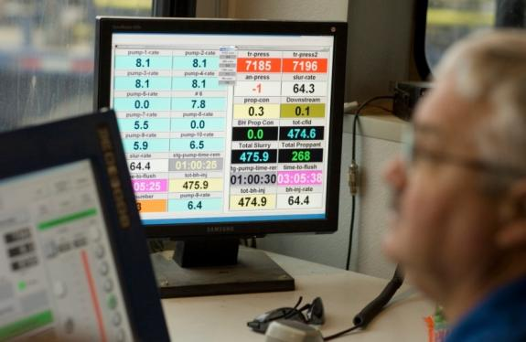
Well Integrity
1
Evaluate Stratigraphic Confinement
2
Well Construction Standards
3
Evaluate Mechanical Integrity of Well
4
Monitor Frac Job & Producing Well

Slide 9
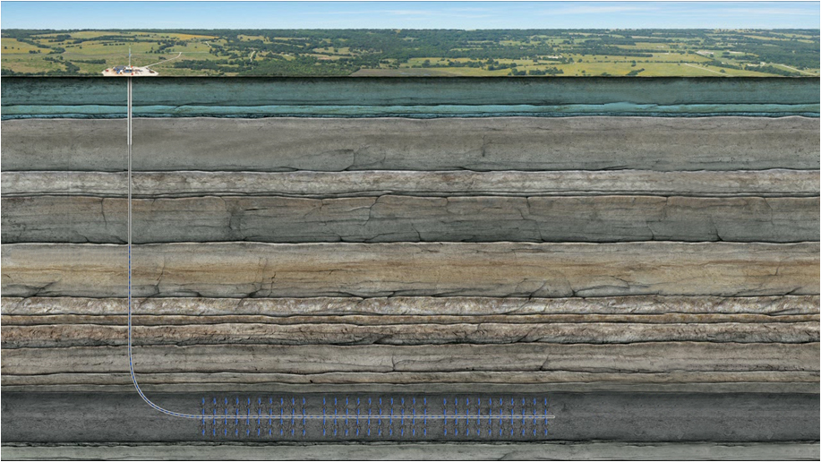
1. Evaluating Stratigraphic Confinement
Virtually all fresh water wells are less than 500 feet deep in the Fayetteville Shale area
400’ Usable Fresh Water
Surface Casing 550’
2100’ Various Atoka
Sands & Shales
4000’ of Sediment
Thousands of feet of rock separates the Fayetteville Shale from shallow, freshwater zones
1300’ Upper Hale
600’ Morrow Shale
300’ Fayetteville Shale
Hindsville
Cross sectional view

Slide 10
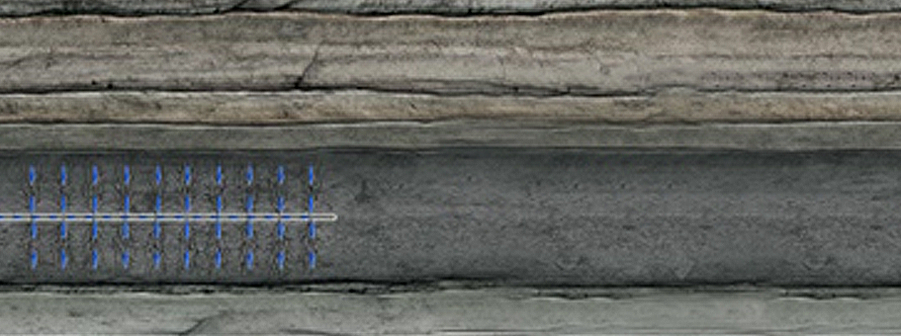
Evaluating Stratigraphic Confinement
Differences in rock properties (i.e. strength and brittleness/elasticity) between the target formation (Fayetteville Shale) and surrounding formations (Morrow Shale and Hindsville Lime) act to contain hydraulic fractures within the target formation.
600’ Morrow Shale
300’ Fayetteville Shale
Hindsville
Hydraulic fractures follow the path of least resistance and continue to propagate within the Fayetteville Shale.
Cross sectional view

Slide 11
Microseismic Evaluation of Stimulation Treatment
Subsea Depth
-2,000’
Top of Morrow Shale
-2,200’
The largest recorded seismic event generates the same amount of energy as would be released when dropping a gallon of milk from chest high to the floor.
-2,400’
-2,600’
Top of Fayetteville Shale
Well Path
~ 200’
-2,800’
Top of Hindsville Lime
-3,000’
Cross Sectional View
1,000’

Slide 12
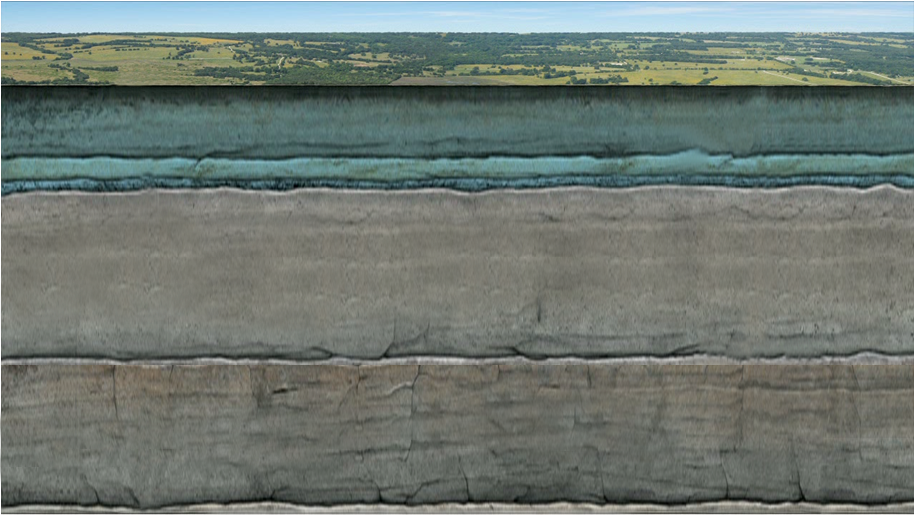
Evaluating Stratigraphic Confinement Shallow Wells
Abandoned Well
400’ Usable Fresh Water
850’
In most shallow formations
(less than ~2,000’), the hydraulic fracture will propagate in a horizontal direction.
Transmissive
Fault
450’ Atoka
Sands & Shales
300’ Fayetteville Shale
Cross sectional view

Slide 13
2. Well Construction Standards
400’ Usable Fresh Water
Surface Casing 550’
2100’ Various Atoka
Sands & Shales
4000’
of Sediment
1300’ Upper Hale
600’ Morrow Shale
300’ Fayetteville Shale
Hindsville
Cross sectional view

Slide 14
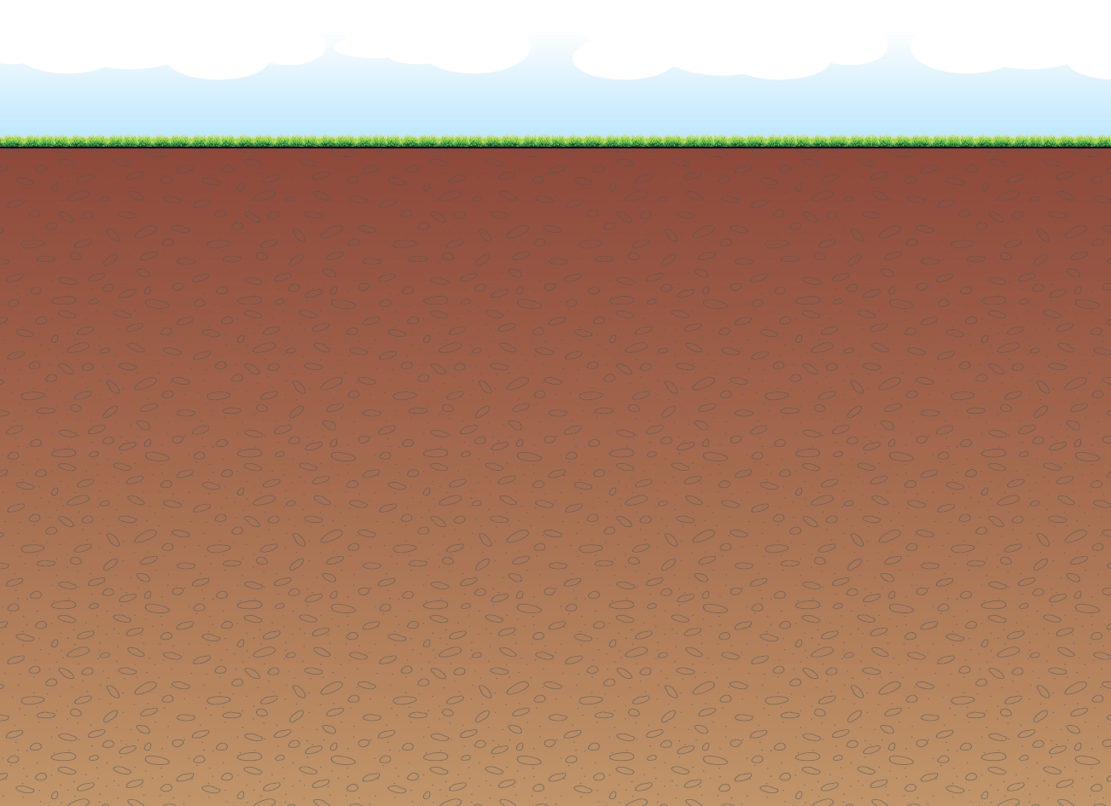
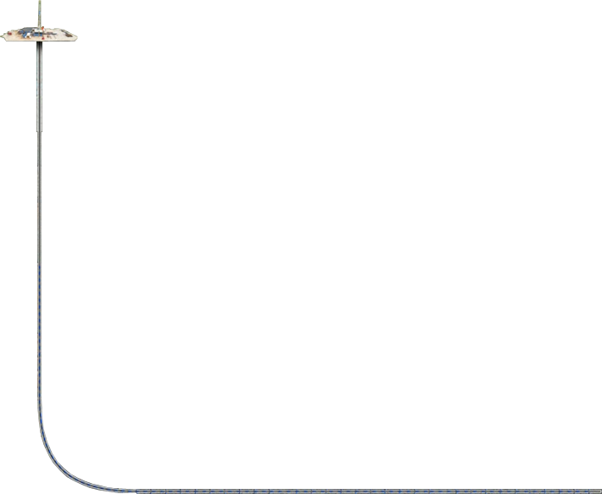
WELL CONSTRUCTION STANDARDS
CONDUCTOR PIPE
CEMENT
FRESH WATER AQUIFER ZONE
SURFACE CASING
CEMENT
400’ Usable Fresh Water
PRODUCTION CASING
Surface Casing 550’
2100’ Various Atoka
Sands & Shales
4000’
of Sediment
SHALLOW PRODUCING ZONE
1300’ Upper Hale
CEMENT
600’ Morrow Shale
300’ Fayetteville Shale
Hindsville
Cross sectional view
TARGET PRODUCING ZONE

Slide 15
3. Evaluating Mechanical Integrity of Well
Internal Mechanical Integrity
Verify appropriateness of proposed casing program (e.g., size, grade, minimum internal yield pressure, etc.)
Test casing string to ensure it can withstand maximum stimulation pressure
External Mechanical Integrity
Verify quality of cement
Identify top of cement
Test cement job (FIT, CBL, etc.) when operations indicate inadequate coverage

Slide 16
GOOD MECHANICAL INTEGRITY
CONDUCTOR PIPE
FRESH WATER AQUIFER ZONE
SURFACE CASING
PRODUCTION CASING
SHALLOW PRODUCING ZONE
TARGET PRODUCING ZONE

Slide 17
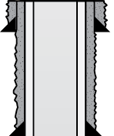
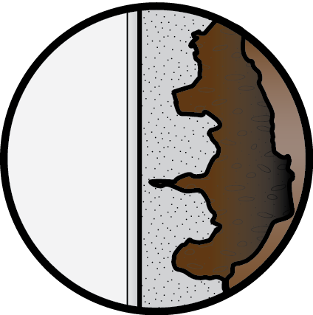
CEMENT CHANNELING
CONDUCTOR PIPE
PRESSURE
BUILDS UP
FRESH WATER AQUIFER ZONE
SURFACE CASING
PRODUCTION CASING
FORMATION
SHALLOW PRODUCING ZONE
CASING
CEMENT
TARGET PRODUCING ZONE

Slide 18
INSUFFICIENT CEMENT COVERAGE
CONDUCTOR PIPE
PRESSURE
BUILDS UP
FRESH WATER AQUIFER ZONE
SURFACE CASING
PRODUCTION CASING
SHALLOW PRODUCING ZONE
TARGET PRODUCING ZONE

Slide 19
4. Monitoring Frac Job and Producing Well
Monitor pump pressure and rate during frac job
Monitor annular pressures during and after frac job
Terminate operations and take corrective action if abnormal pressure responses indicate mechanical integrity failure or fracture growth out of target zone

Slide 20
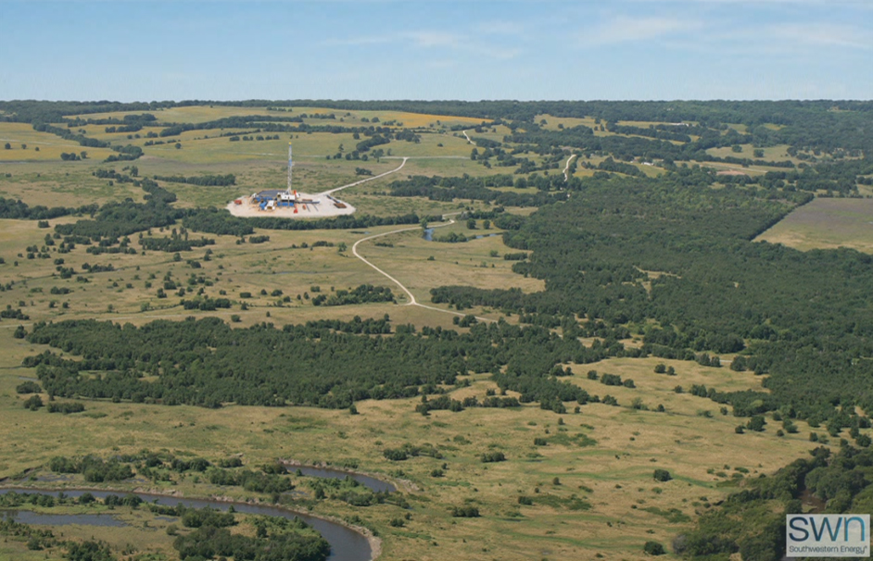
Regulatory Considerations
Surface Considerations
Air Emissions
Surface Impact
Water Supply
Water Handling
Water Reuse & Disposal

Slide 21
Surface Considerations
Air Emissions
Emission Type
NO_{x}
SO₂
CO
CH₄
VOCs (incl. BTEX)
Reduction Technology
Catalytic reduction
Ultra-low sulfur diesel fuel
LNG and CNG fuels
Oxidation catalysts
Green completions, vapor recovery units, low bleed/no bleed pneumatic devices, plunger lift systems, leak detection
Emission Levels
EPA
Industry
State regulators
Research groups

Slide 22
Fulfilling the Promise of Natural Gas
Straight talk/open dialogue
Debate the real issues
Regulation without the politics
Natural Gas Industry
Natural Gas Industry
Natural Gas Industry
Environmental Groups
Environmental Groups
Natural Gas Industry
Environmental Groups
Regulators/Legislators
Regulators/Legislators

Slide 23
Drawing the Blueprint for a Sustainable Natural Gas Future
Denver, Colorado
January 18, 2012
Mark K. Boling
Executive Vice President & General Counsel

